Slide 1

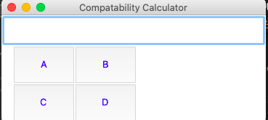
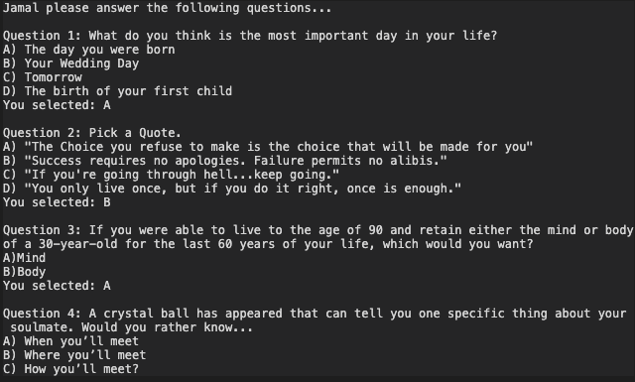
Love Line
Github LInk
A compatibility calculator.
Find out how similar you really are…
Jamal Fox

